Slide 1



Welcome to SUKooN: Your Stress-Relieving Oasis
Discover a sanctuary where stress melts away and inner peace blossoms. SUKooN is your gateway to a holistic wellness journey, empowering you to reclaim your mental and emotional wellbeing.

Slide 2

Laughing Therapy
1
Boost Mood
2
Reduce Stress
Laughter has a profound effect on our mental state, triggering the release of feel-good hormones that can instantly lift our spirits.
Laughing therapy helps us let go of tension and worries, providing a much-needed break from the stresses of daily life.
3
Strengthen Connections
Shared laughter fosters social bonds and strengthens relationships, creating a sense of community and belonging.

Slide 3
Reading Therapy
Escape Reality
Reduce Anxiety
Improve Focus
Reading transports us to new worlds, allowing us to step away from our daily concerns and immerse ourselves in captivating narratives.
The act of reading can have a calming effect, slowing our thoughts and helping us find inner peace and clarity.
Reading requires sustained attention and concentration, which can strengthen our cognitive abilities and enhance our overall mental well-being.

Slide 4
Daily Affirmations
Boost Self-Esteem
Cultivate Optimism
Repeating positive affirmations can help build self-confidence and overcome negative self-talk, empowering us to embrace our true worth.
Focusing on affirmations that promote a positive mindset can reshape our perspective and help us approach life with greater optimism.
Manifest Intentions
Reduce Stress
Daily affirmations can serve as powerful tools for manifestation, aligning our thoughts and actions with our desired outcomes.
The practice of affirmations can help us let go of worries and redirect our focus to more constructive and empowering thoughts.

Slide 5




Audio Therapy
Soothing Music
Binaural Beats
Nature Sounds
Guided Meditations
Immerse yourself in the healing power of music, with carefully curated playlists that transport you to a state of deep relaxation.
Explore the transformative effects of binaural beats, which can induce a meditative state and enhance cognitive function.
Soothe your senses with the calming sounds of nature, from the gentle rustling of leaves to the soothing rhythm of waves.
Embark on a journey of self-discovery with our selection of guided meditations, tailored to address a variety of needs and preferences.

Slide 6
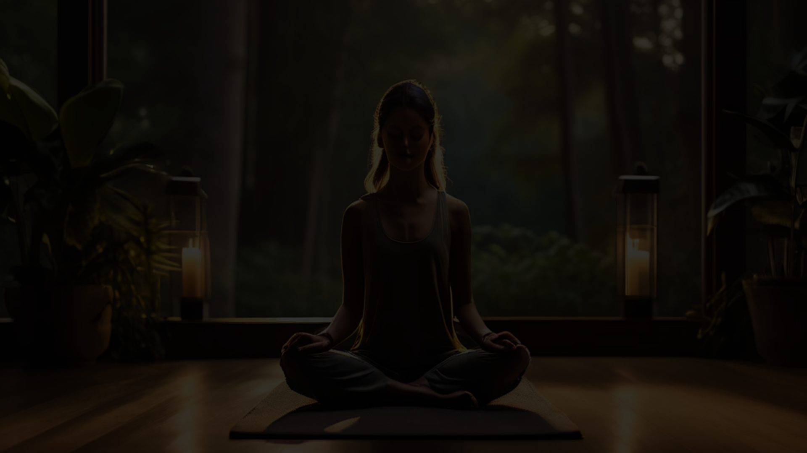

Yoga Therapy
Enhance Flexibility
1
Yoga helps improve flexibility, allowing you to move with greater ease and reducing the risk of injury.
2
Promote Mindfulness
The practice of yoga encourages a state of deep focus and presence, helping you cultivate a more mindful approach to life.
Reduce Stress
3
The combination of physical poses, breath work, and meditation in yoga can effectively alleviate stress and promote a sense of calm.

Slide 7

Talking Therapy
Explore the Benefits of Talking Therapy
Connect with Our Experienced Therapists
Schedule Your Confidential Consultation

Slide 8





Consult a Doctor
Assess Your Needs
During your consultation, our medical professionals will thoroughly evaluate your physical and mental health to determine the best course of action.
Develop a Plan
Based on their findings, they will work closely with you to develop a personalized treatment plan that addresses your specific concerns and goals.
Ongoing Support
Your doctor will provide you with the guidance, resources, and follow-up care needed to ensure your long-term health and wellbeing.

Slide 9
Explore Our Therapeutic Offerings
Child Therapy
Spiritual
Nurture your child's emotional and mental wellbeing with our specialized programs designed to address developmental needs, social challenges, and behavioral concerns.

